Slide 1
Algorithms complexity and optimization
Romain Lhotte

Slide 2
Plan
Seq 1: Introduction, probably things you already know, primes and fast exponentiation
Seq 2: Abstract Data Type & Data Structure. Array & Linked Lists.
Seq 3: Queue & Stack. Sorting.
Seq 4: Sets with arrays. Two Pointers.
Seq 5: Some exercises. Set with hashing.
Seq 6-8: Graphs (slide dominant), trees, DFS, BFS, priority queues
Seq 9: Exercises
Seq 10: Exam (MCQ & 2 coding exercises & GPT/Copilot not allowed)

Slide 3
Information about the class 1/2
We will only use Python but everything we learn can be applied to other languages.
15% slide, 60% writing code, 20% handwriting, 5% printed notes.
If you don’t have your computer or your computer doesn’t work, pair up with a friend
I don’t mind if you’re late, just sit and don’t interrupt. I won’t lock the attendance thing online too early on.
If you want to use GPT or Copilot or else during the exercise session, go for it, just be aware that you won’t have it for the exam.

Slide 4
Information about the class 2/2
Exam is MCQ, one exercise selected from the set of exercises we did together, and one ‘new’ exercise. We will do a mock exam together.
If your Python does not work locally, use Google Colab or any online IDE.
If I’m going too fast, tell me, I can slow down, if I’m going too slow, tell me, we can cover (way) more advanced algorithms.

Slide 5
Problems
A problem is a description of a mapping between inputs and outputs.
It doesn’t list all inputs and all outputs, it’s just natural language.
To know if you correctly solve the problem, you can prove your solution is correct mathematically.
Or you can try all inputs and check if you get the right output every time.
If all inputs is too much, we often consider that if it works on around 1000 tests that include edge cases … it works.

Slide 6
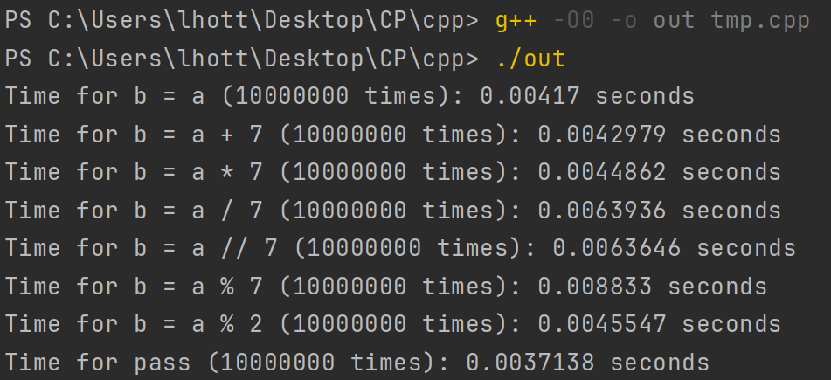
Assumptions
Accessing any point in memory is O(1)
Modulus, division, integer division, and addition are all considered O(1)
In Python everything is slower, and it’s harder to see the differences
%2 seems to be fast, why is that?
Notes:
Explain timeit quickly. Explain that these differences would be more significant in lower level language

Slide 7
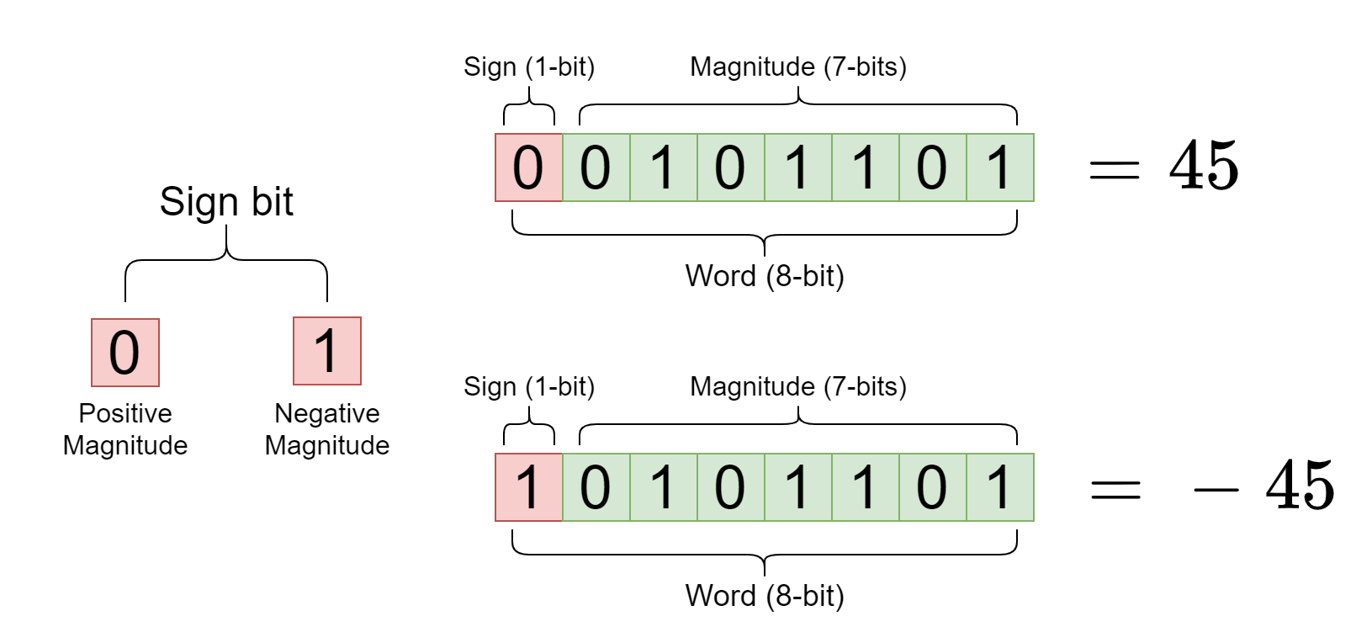
Binary number
Why is %2 fast?

Slide 8
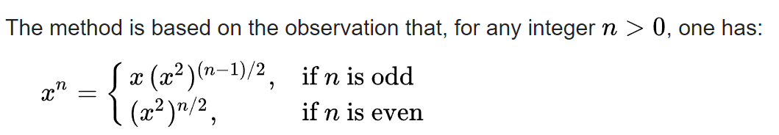
Fast exponentiation
3¹³ with 13 operations (3*3*3*3*…*3)
Possible with only 5 operations
a=3*3 (3²), b=a*a (3⁴), c = b*b (3⁸), d = 3*b*c

Slide 9
Frequently asked questions
If I do import math; math.pow(3, 13), I’ll get the answer, and it uses fast exponentiation, why bother?
Notes:
To understand the more complicated non-useless things, you have to understand the things you will never use because people have already implemented them.

Slide 10
Prime numbers
Two algorithms to know:
is_prime(n)
count_primes(n)

